Slide 1
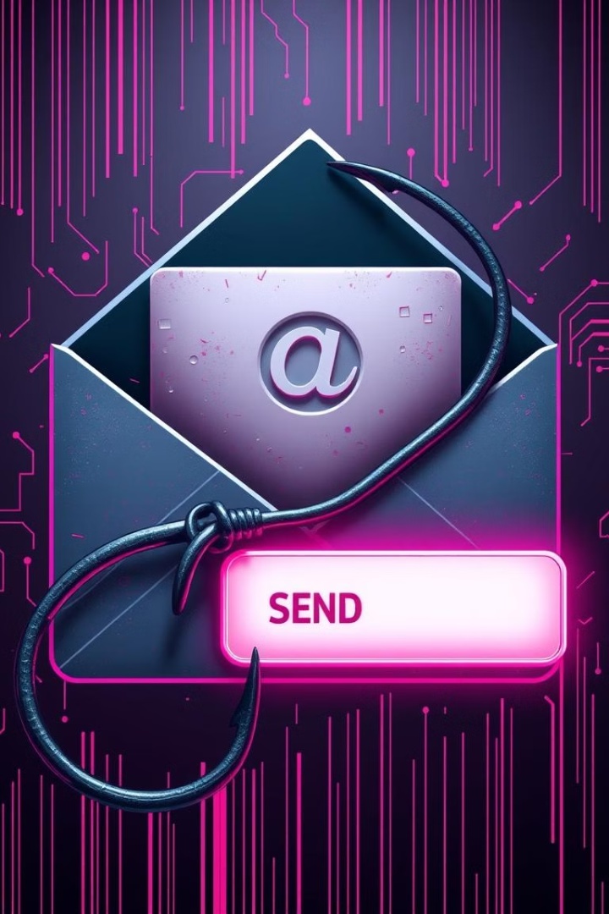

Phishing: Hook, Line, and Sinker - Don't Get Caught!
Learn to identify and sidestep phishing attacks. Recognize deceptive emails, websites, and social engineering tactics to protect yourself and your valuable data.

Slide 2
What is Phishing? Defining the Threat and its Evolution
Definition
Evolution
Goal
Phishing is a cybercrime that uses deceptive emails or websites. It's designed to steal sensitive information.
Phishing attacks have become more sophisticated. Attackers now use advanced social engineering techniques.
The goal is to trick users into revealing personal data. This includes passwords, credit card numbers, and more.

Slide 3

Spotting the Bait: Red Flags in Phishing Emails
1
Generic Greetings
2
Urgent Requests
Be wary of emails with "Dear Customer" or similar greetings.
Phishing emails often demand immediate action.
3
Typos and Grammar
4
Suspicious Links
Poor grammar and spelling are common in phishing attempts.
Hover over links to check the actual destination.

Slide 4
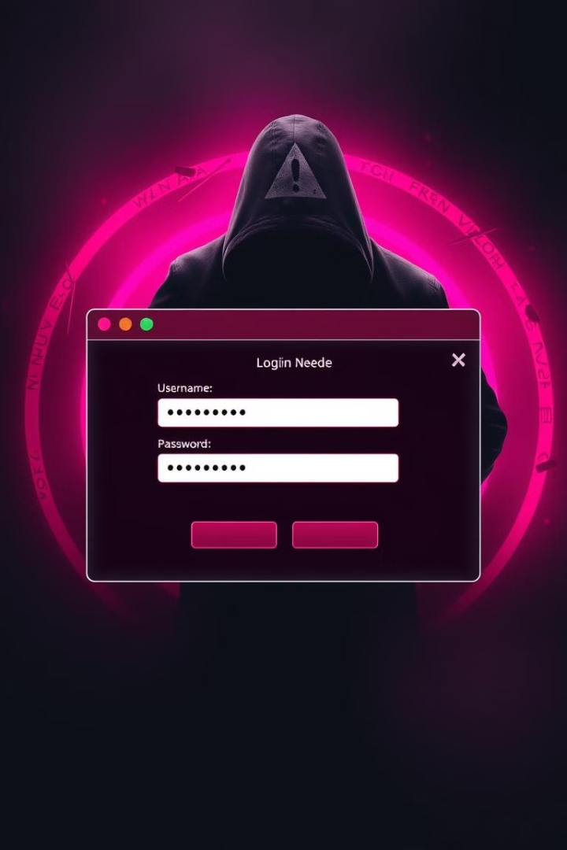



Fake Websites: How to Identify Deceptive Online Traps
Check for HTTPS
Inspect the URL
Verify Security
Look for a padlock icon and "https" in the address bar.
Ensure the domain name is legitimate and not a variation.
Look for trust badges and security certifications.

Slide 5





Social Engineering: The Art of Manipulation
Pretexting
Creating a false scenario to trick victims.
Baiting
Offering something enticing to lure users.
Quid Pro Quo
Offering a service in exchange for information.
Tailgating
Gaining access to secure areas by following someone.

Slide 6

Protect Yourself: Practical Tips for Avoiding Phishing Scams
Be Skeptical
Question any unsolicited requests for personal information.
Verify
Contact the organization directly to confirm legitimacy.
Use Strong Passwords
Create unique, complex passwords for each account.
Enable Multi-Factor Authentication
Add an extra layer of security to your accounts.

Slide 7
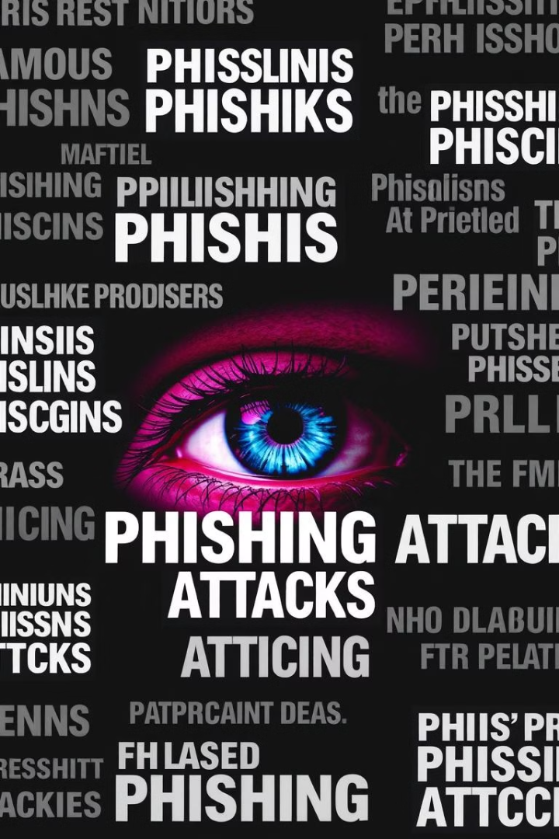
Case Studies: Learn from Others' Mistakes
1
2015: Ubiquiti Networks
Lost $46.7 million due to a phishing email.
2
2016: Bangladesh Bank
Attackers stole $81 million using fraudulent SWIFT messages.
3
2020: Twitter
High-profile accounts were compromised in a social engineering attack.

